Slide 1
Securing Containerized Resources
Team: 28 Panel Number: P5
S.No | Reg.No | Name of the Student | Section
1. | CB.EN.U4CSE18004 | ANIRUDH B | CSE A
2. | CB.EN.U4CSE18149 | SHASHANK V BARATWAJ | CSE B
3. | CB.EN.U4CSE18230 | KAILAASH B | CSE C
4. | CB.EN.U4CSE18401 | AADHITYA TEJASWIN P S | CSE E
Project Mentor: Dr. Abirami K, Asst. Professor, CSE

Slide 2
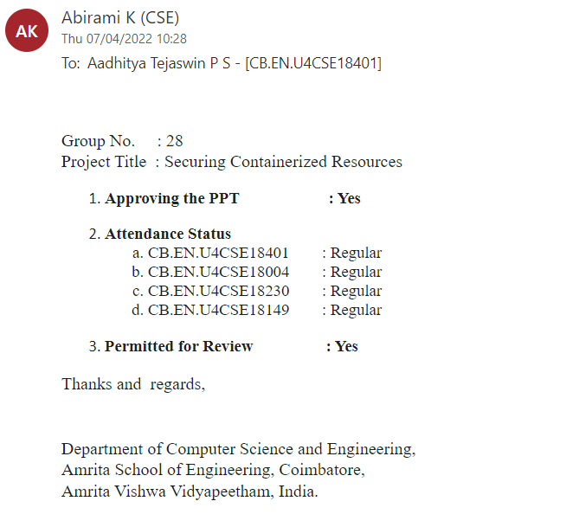
Guide Approval Mail

Slide 3
Problem Statement
To improve security of containerized environments by following the best practices and, Hardening and Auditing containers

Slide 4
Abstract
A container is a standard unit of software that packages up code and all its dependencies so the application runs quickly and reliably from one computing environment to another. Docker is a set of platform as a service products that use OS-level virtualization to deliver software in packages called containers. Container images become containers at run-time and in the case of Docker containers – images become containers when they run on Docker Engine. Containers are isolated from one another and bundle their own software, libraries and configuration files; they can communicate with each other through well-defined channels. But at the default configuration it exposes lot of vulnerabilities of underlying host and the container , which can be exploited. We propose a hierarchical approach to secure a docker environment. Securing involves various stages such as best security practices for containers, Hardening and Auditing containers to improve the security posture of docker environment and securing containerized infrastructure

Slide 5
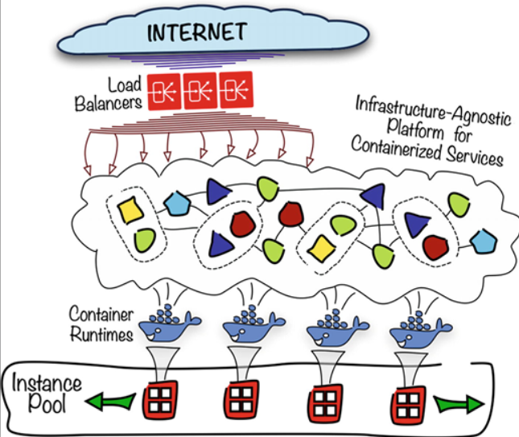

Slide 6
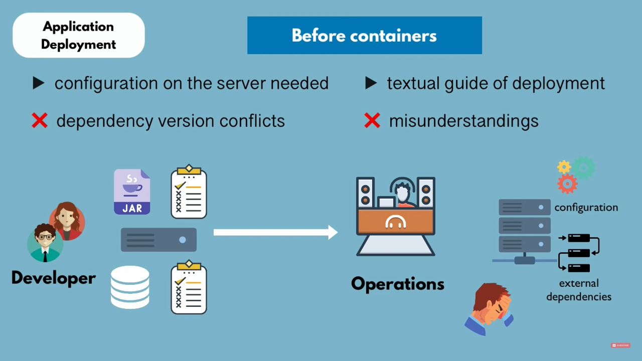
Need of a Docker Container

Slide 7
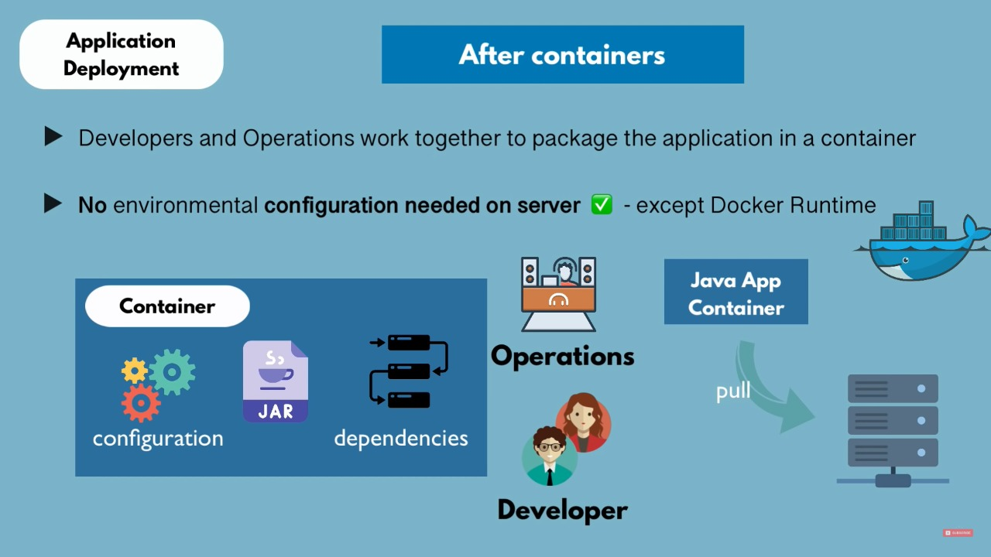
Need of a Docker Container

Slide 8
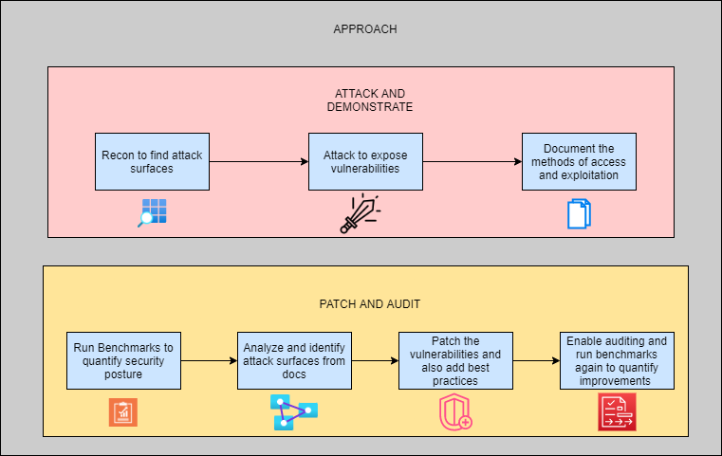
Approach

Slide 9
DDoS Attack
A distributed denial-of-service (DDoS) attack is a malicious attempt to disrupt the normal traffic of a targeted server by overwhelming the target with a flood of Internet traffic.
DDoS attacks achieve effectiveness by utilizing multiple compromised computer systems as sources of attack traffic
From a high level, a DDoS attack is like an unexpected traffic jam clogging up the highway, preventing regular traffic from arriving at its destination.
NOTE : Our ultimate aim here is that, even if the container crashes during a DOS attack, the server running the docker will not crash. For that purpose we restrict resource consumption using cgroups

Slide 10
Control Groups
A cgroup associates a set of tasks with a set of parameters for one or more subsystems.
Cgroups allow you to allocate resources - such as CPU time, system memory, network bandwidth, or combinations of these resources - among user-defined groups of tasks running on a system.
By using cgroups, system administrators gain fine-grained control over allocating, prioritizing, denying, managing, and monitoring system resources.

Slide 11
Control Group Subsystems
CPU → Manage and control access to CPU usage
CPUSET → CPU cores assignment and management
MEMORY
PIDs → Limit number of processes
BLKIO → I/O operations
DEVICES → Control access to devices

Slide 12
Cgroups in Docker
Docker uses cgroupsfs to manage and maintain cgroups associated with containers.
Systemd can also be used for this purpose.
Control can be for containers system-wide or container by container basis.

Slide 13
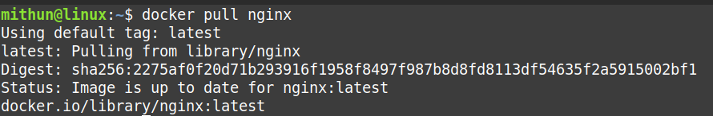
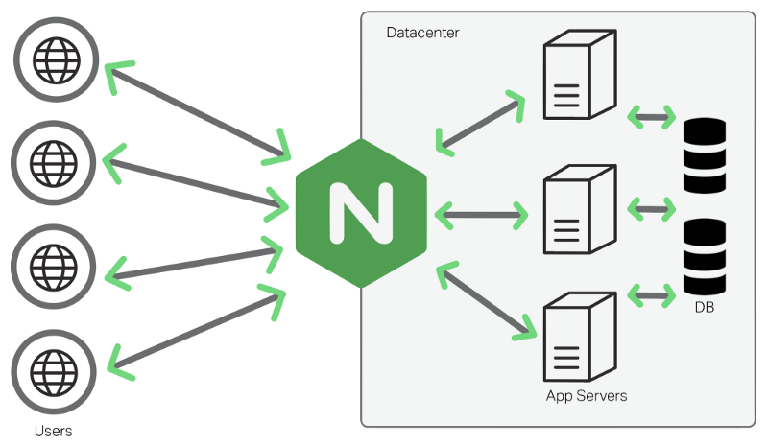
Implementation
This command is used to import the official image of nginx from Docker Hub.
What is nginx?

Slide 14
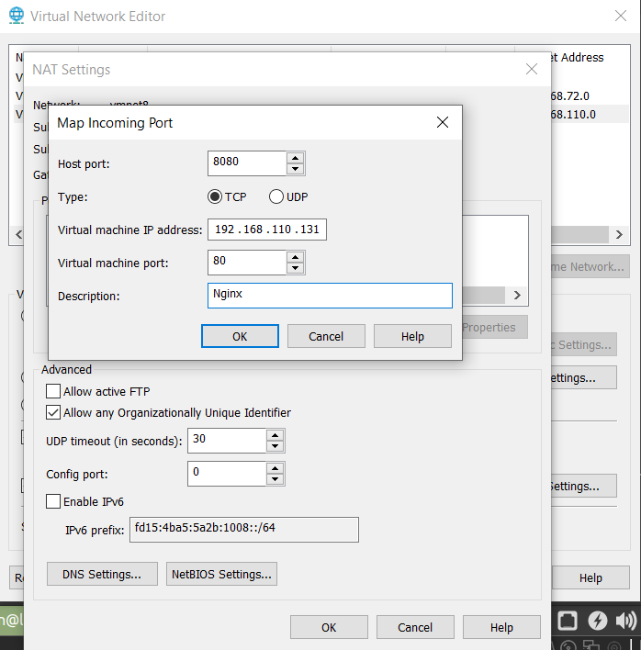
Implementation
test is the name of the created container based on the NGINX image.
the -d option specifies that the container runs in detached mode: the container continues to run until stopped but does not respond to commands run on the command line.
the -p option tells Docker to map the ports exposed in the container by the NGINX image (port 80) to the specified port on the Docker host.
Nginx will run in port 80 in the VM. To access it outside the website, we port forward it to our system

Slide 15
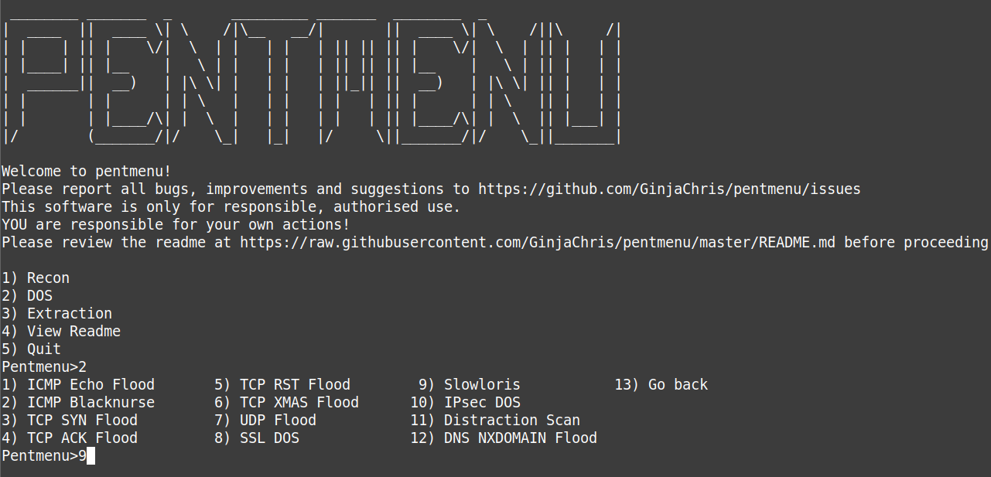
Implementation
With the help of PENTMENU we perform a Slowloris DOS attack on nginx.

Slide 16
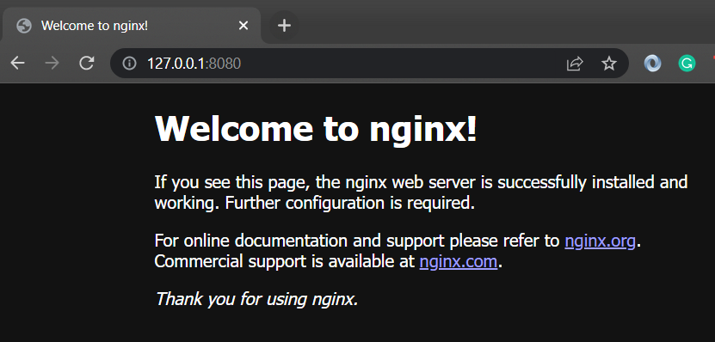
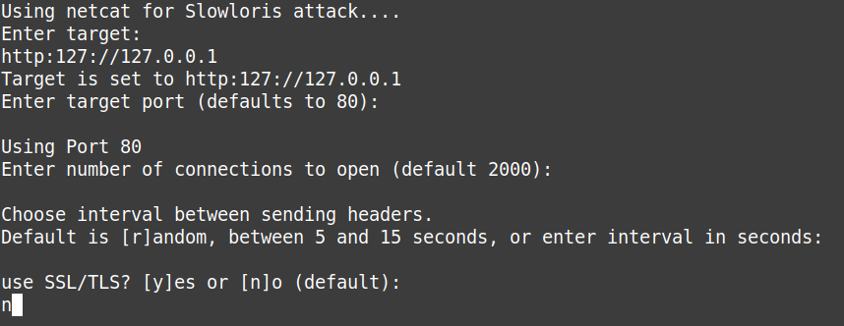
Implementation
The nginx web server can be accessed in the localhost (http://127.0.0.1:8080)

Slide 17
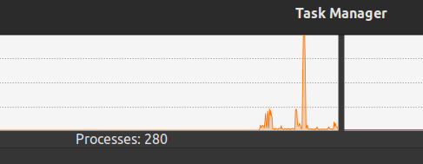
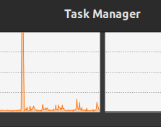
Implementation
Reducing the cpus for the task from 4 to 1
CPU usage spike observed after DOS attack on nginx.
CPU usage spike after restricting resources =>

Slide 18
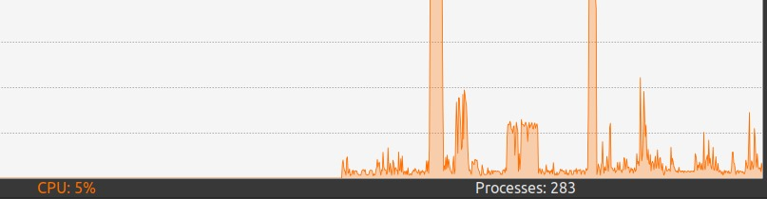
Results and Inference
The width of the second peak is smaller than the first peak indicating that we have constrained the resources. Here, it will take extra resources to run the script. In the example, we have only 2000 requests, hence a usage spike can be seen. In case of 10000 to 20000 requests, the whole system will crash. Our ultimate aim here is that even if the docker container crashes, the server running the docker will not crash, because there are other resources that work on the server.

Slide 19
References
1) T. Combe, A. Martin and R. Di Pietro, "To Docker or Not to Docker: A
Security Perspective," in IEEE Cloud Computing, vol. 3, no. 5, pp. 54-62,
Sept.-Oct. 2016, doi: 10.1109/MCC.2016.100.
2) A. Tomar, D. Jeena, P. Mishra and R. Bisht, "Docker Security: A Threat
Model, Attack Taxonomy and Real-Time Attack Scenario of DoS," 2020
10th International Conference on Cloud Computing, Data Science &
Engineering (Confluence), 2020, pp. 150-155, doi:
10.1109/Confluence47617.2020.9058115

Slide 20
References
https://ieeexplore.ieee.org/abstract/document/7346917/
https://ieeexplore.ieee.org/abstract/document/8169747/
https://github.com/docker/docker-bench-security
https://docs.chef.io/inspec/install/
https://github.com/quay/clair
https://github.com/aquasecurity/trivy
https://github.com/inspec/inspec
https://cisofy.com/documentation/lynis

Slide 21
References
https://github.com/genuinetools/bane
https://github.com/moby/moby
https://linux.die.net/man/8/auditd
https://wiki.ubuntu.com/AppArmor
https://docs.docker.com/engine/security/seccomp/
https://docs.docker.com/engine/security/apparmor/
https://docs.docker.com/engine/security/

Slide 22
THANK YOU

